Slide 1



Determining a Classifier Threshold of NBC
Ben Brobbey, Sierra Freytiz, Drew Mangione, Timothy Wilmes, Maitland Witmer
Notes:
Sierra

Slide 2
Agenda
Exploratory learning with Naïve Bayes Classifier
Background on the Project
Our Problem Statement
Materials and Methods
Results
Conclusion
Notes:
Sierra

Slide 3
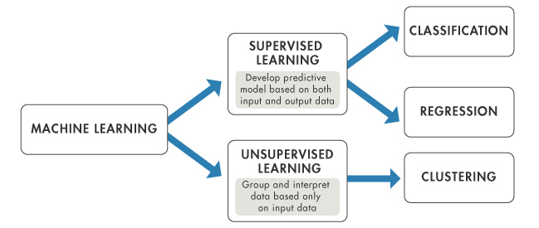
Exploratory Learning
Helps identify the contents of sequences and groups them by feature similarities
i.e. Uses specific information about the general data to classify sequences in their respective groups
Takes in large hierarchal sets of categories (super-kingdom, class, phylum, order)
Notes:
Sierra

Slide 4
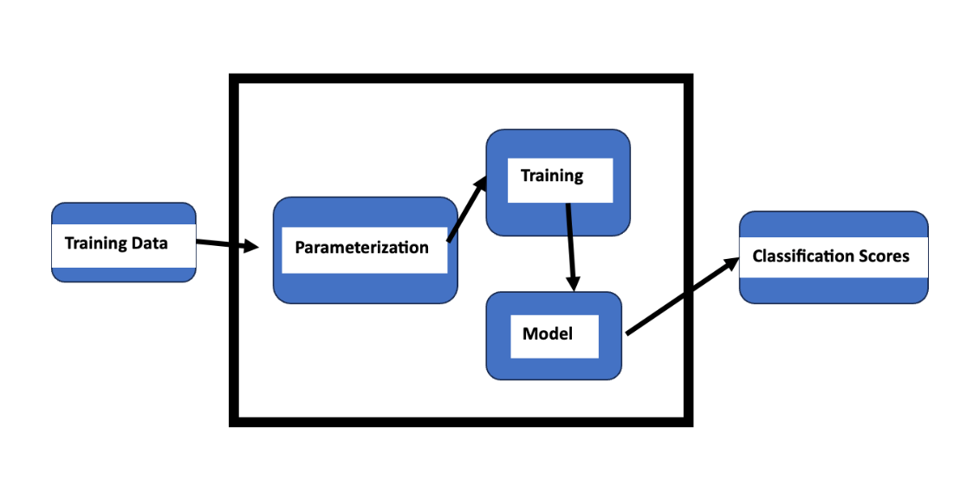
Machine learning
Notes:
Ben

Slide 5
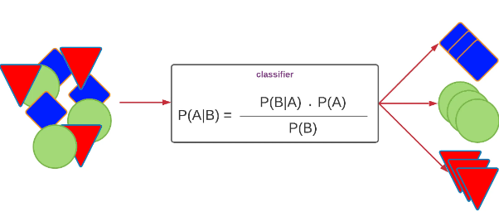
Naïve Bayes Classifier
Supervised Algorithm
Learns Incrementally
Does not need to be retrained on new data each time
Faster than existing methods database updates methods
Notes:
Ben

Slide 6
Background
Semi-supervised learning may suffer from unexpected sequences in a dataset.
Classification of this unknown data is essential for:
Diagnosing Diseases
Environmental Monitoring
Vaccine Development
Taxonomic Classification of Microorganisms
Notes:
Ben

Slide 7
Problem statement
Train a Naïve Bayes Classifier algorithm on select data and see how well it classifies unseen organisms based on how closely related it is to the training data.
Closeness to is to be determined by a threshold value given by the trained algorithm and use this value as reference to how well NBC recognizes unlabeled.
Notes:
Tim

Slide 8
Materials and Method
Materials:
Data → provided by Dr. Rosen
Picotte
Python
Methods:
Outlined in the following slides
By tasks provided
Notes:
Tim

Slide 9
Obstacles encountered
Lack of documentation for Naïve Bayes Classification
Challenges with handling large amount of data
Limited knowledge of Picotte
Underestimation time to complete initial steps
Notes:
Tim

Slide 10
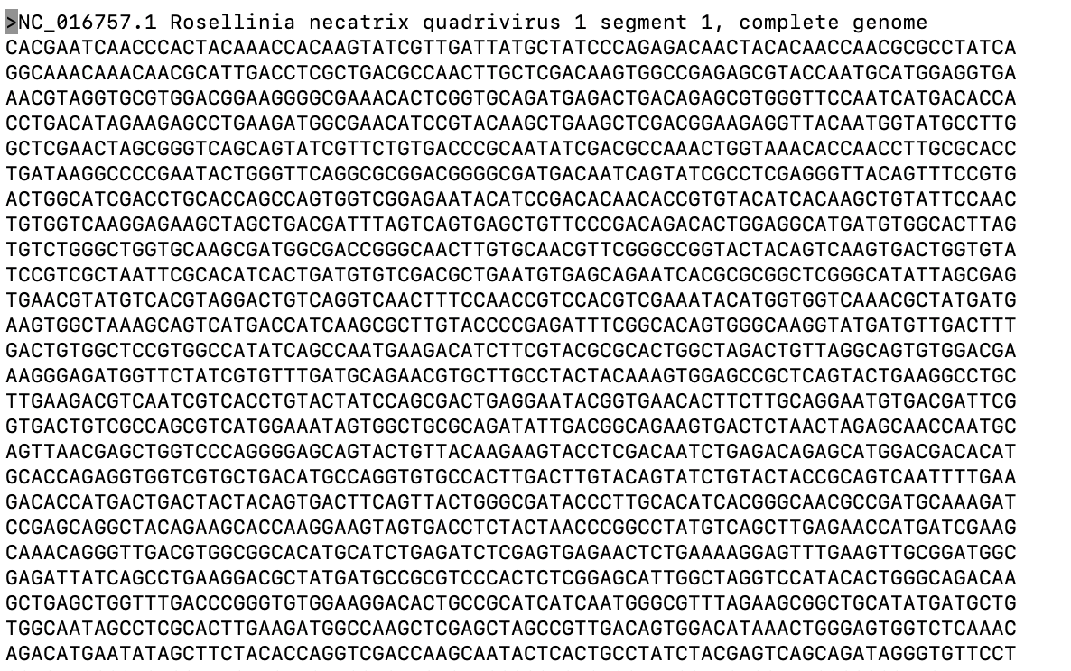
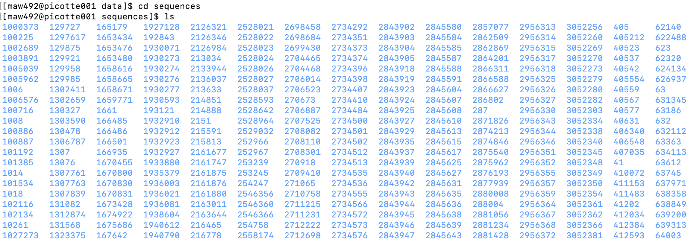
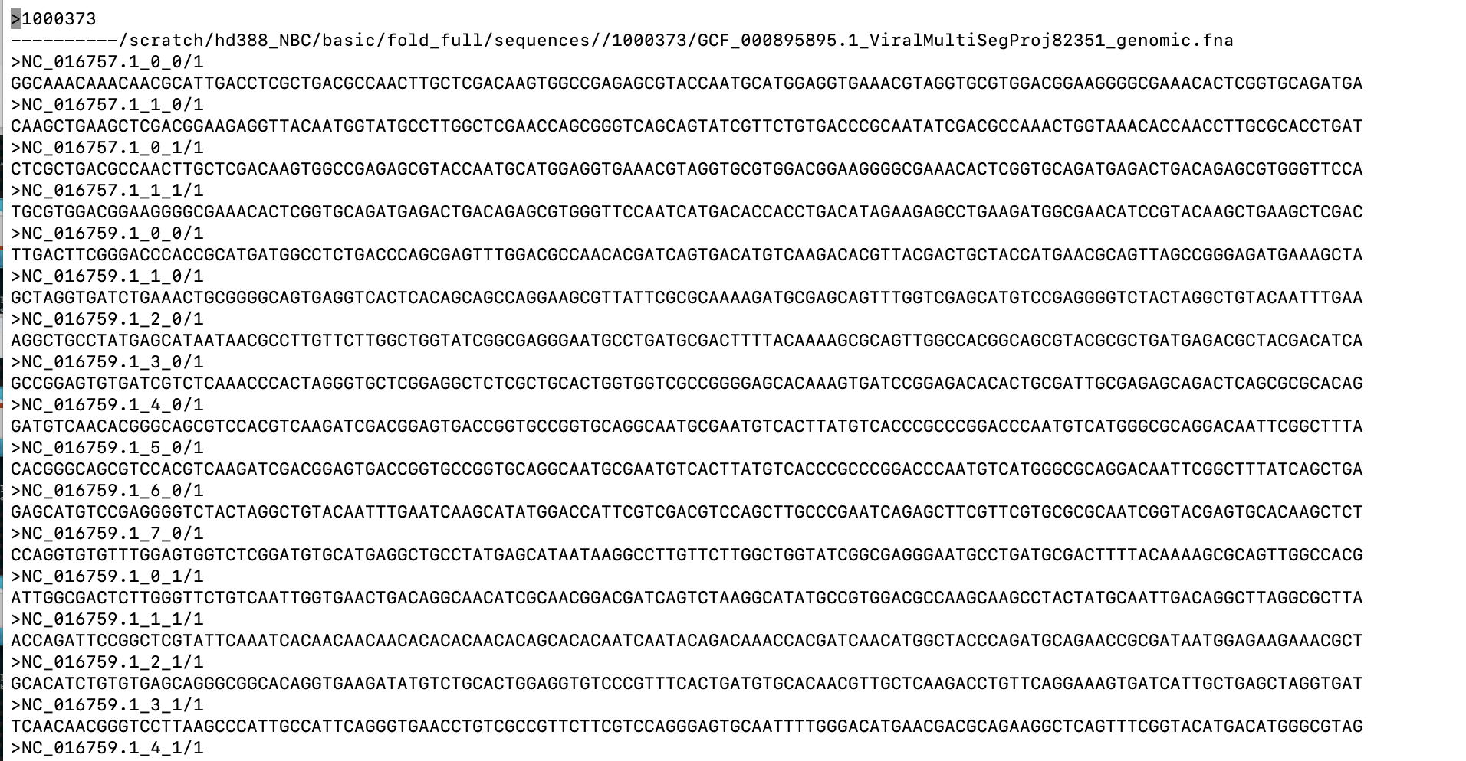
Results
Task 1: Understand the provided data sets and divide the training into 50/40/20%
Testing sequences file
Notes:
Maitland: When opening the provided data there are two folders that we can look into. First is sequences and the other is testing_sequence. The sequences folder contains folders that are numbered and with each of those folders is a complete genome of a virus, bacteria, archaea or eukaryotes. As pictured on the right. The testing sequence folder contains a subset of sequences that are all within one file.

Slide 11
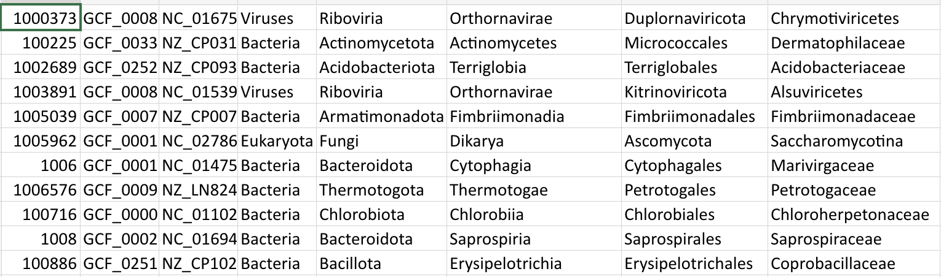
Results
Task 1: Understand the provided data sets and divide the training into 50/40/20%
To better code the division for training, we created a master file that linked all the folder numbers with the genomes
Notes:
Maitland

Slide 12
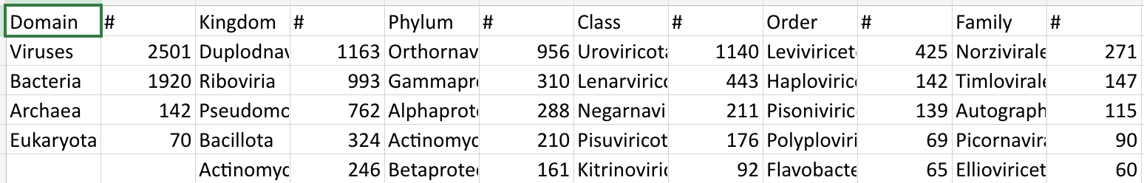
Results
Task 1: Understand the provided data sets and divide the training into 50/40/20%
To better code the division for training, we also created an abundancy file
Notes:
Maitland

Slide 13
Results
Task 1: Understand the provided data sets and divide the training into 50/40/20%
Division of data
Called this half training
Full testing database
50%
Near: 10 sequences from the same taxa level
50%
Create a two testing sequences from what wasn't taken
Far: 10 sequences from the same taxa level above
Notes:
Maitland

Slide 14
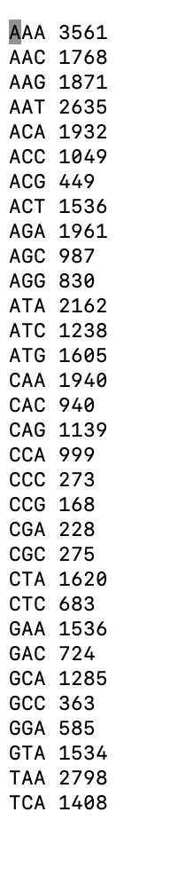
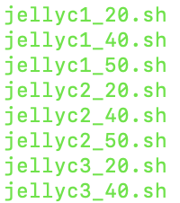
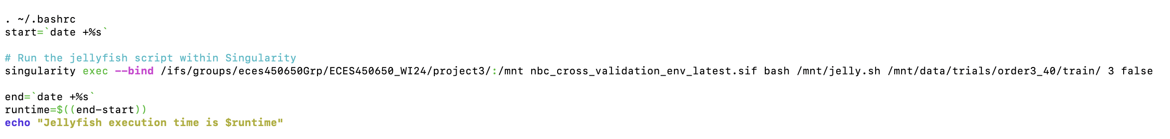
Results
Task 2: Run the training in the NBC program
Created jellyfish files for each training set
5 groups for each level of classification
Where we want singularity to look
NBC program
Use canonical method
Jellyfish
Notes:
Maitland

Slide 15
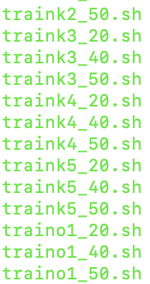
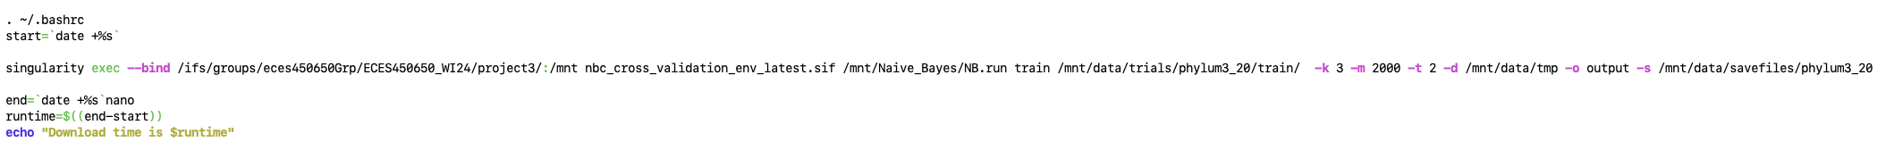
Results
Task 2: Run the training in the NBC program
Created jellyfish files for each training set
5 groups for each level of classification
Tell singularity to look here
Train this
Parameters
Notes:
Maitland

Slide 16
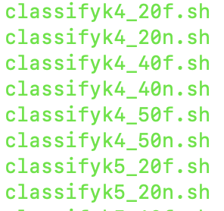
Results
Task 3: Classify the created testing data based on the corresponding training
Notes:
Maitland

Slide 17
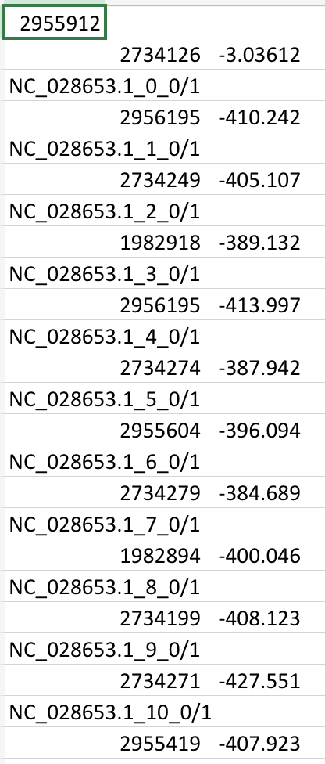
Results
Task 3: Classify the created testing data based on the corresponding training
Notes:
Maitland

Slide 18
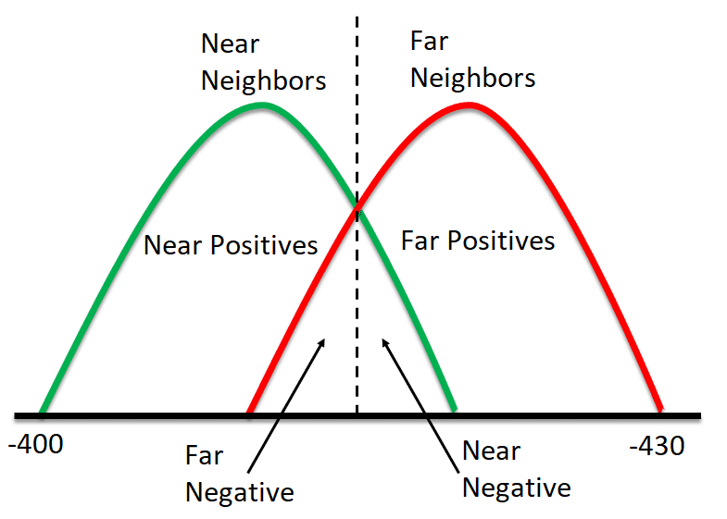
Results
Task 4: Extract and organize results
Threshold
Notes:
Drew

Slide 19
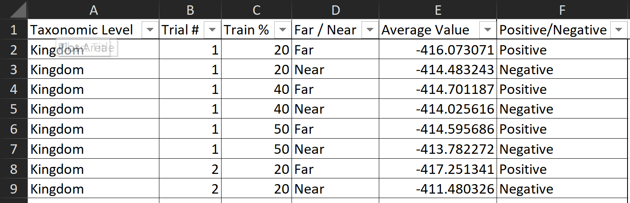
Results
Task 4: Extract and organize results
Notes:
Drew

Slide 20
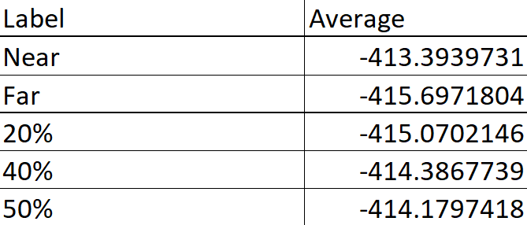
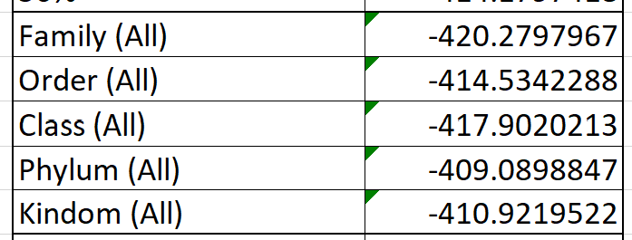
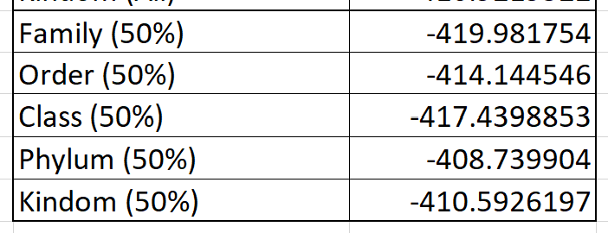
Results
Task 4: Extract and organize results
Notes:
Drew

Slide 21
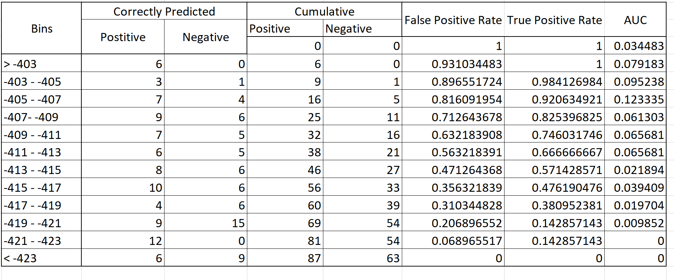
Results
Task 4: Extract and organize results
Notes:
Drew

Slide 22
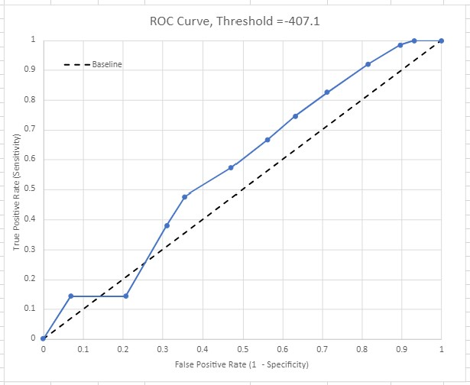
Results
Task 4: Extract and organize results
Notes:
Drew

Slide 23
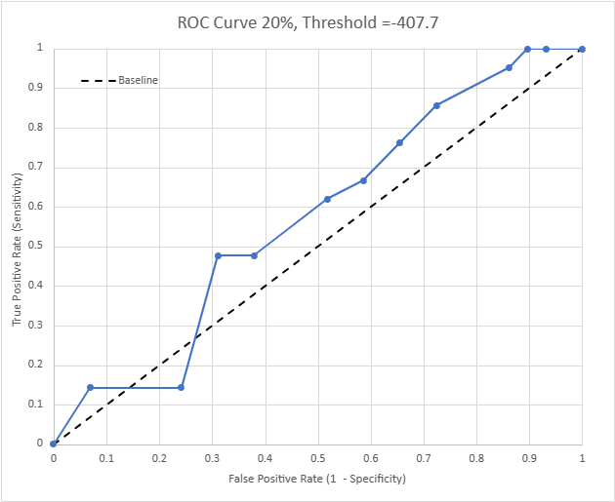
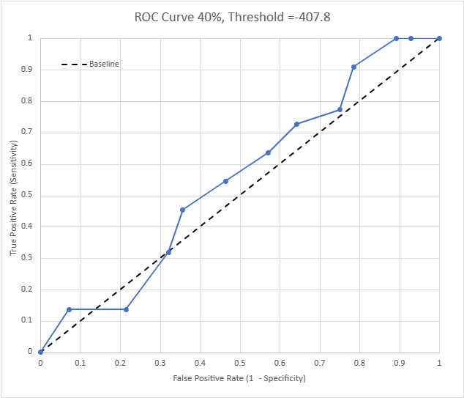
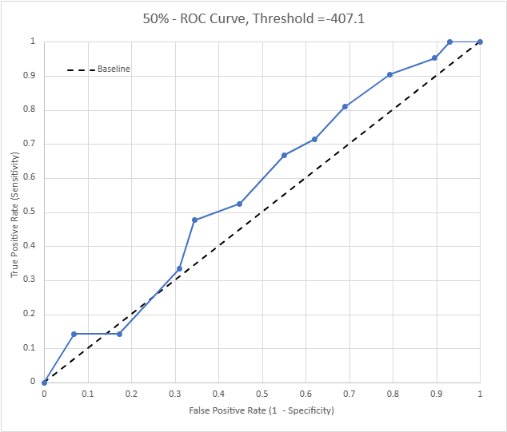
Results
Task 5: Compare the ROC curves of the 50%, 40%, and 20% of the training data to see how the curves changes
Notes:
Drew

Slide 24
Conclusion
NBC is able to distinguish between near and far genetic neighbors
The correlation is not very high, but more training data and trials could improve the results
Notes:
Drew

Slide 25
References
Dalvi, Bhavana, William W. Cohen, and Jamie Callan. "Exploratory learning." In Machine Learning and Knowledge Discovery in Databases: European Conference, ECML PKDD 2013, Prague, Czech Republic, September 23-27, 2013, Proceedings, Part III 13, pp. 128- 143. Springer Berlin Heidelberg, 2013.
Zhao, Z., Cristian, A. & Rosen, G. Keeping up with the genomes: efficient learning of our increasing knowledge of the tree of life. BMC Bioinformatics 21, 412 (2020). https://doi.org/10.1186/s12859-020-03744-7

